Slide 1

Customer Behaviour And Satisfaction Analysis

Slide 2
Introduction
The goal of this is to analyse what are the various factors which needs to be taken care of, to understand the customer behaviour and ensure customer retention.
Analysis Focused on;
Distribution/market places
Product category
Reviews
Delivery time
Freight and price values

Slide 3

General Overview of the Performance
The analysis is for two years from 2016 to 2018.
There are over 99 000 items ordered during the two fiscal years.
97 % of the orders have been delivered.
In 2018, we see that there was a significant growth in revenue comparing it to 2017, which is really good indicator for a business that is working on growth
We had 44,338 customers in 2017 and the number increased to 53,382 in 2018. This might be a good indicator of customer retention and growth.
Highest recorded number of orders where in November, black Friday.

Slide 4
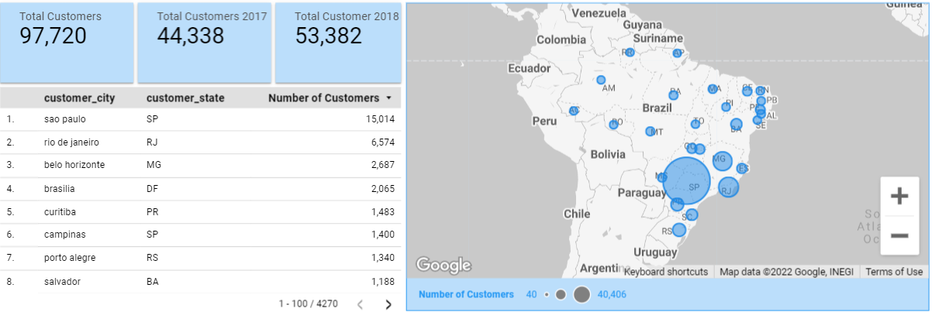
Distribution of customers
42% of total consumers are from the SP(São Paulo), 12.9 % are from RJ(Rio de Janeiro) and 11.7 % are from MG(Minas Gerais) which means most of consumers are from these states.
Also, from the map we can observe these are neighboring states these states are most active.

Slide 5
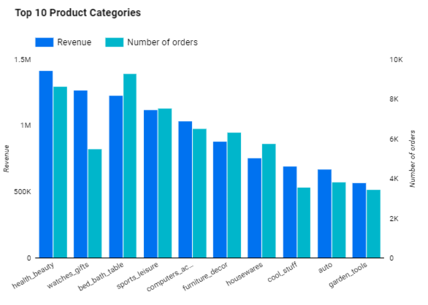
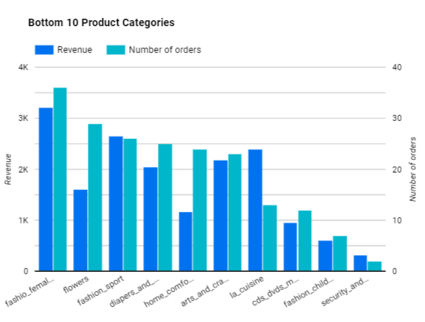
Customer Product Preferences
The most in—demand product categories are bed_bath_table and healthy beauty. We should focus on these categories to ensure good customer experience.
Bottom 10: They have few products items and some of them are out of fashion such as cds_dvds
Top 10 products categories have more product items than the bottom 10.

Slide 6
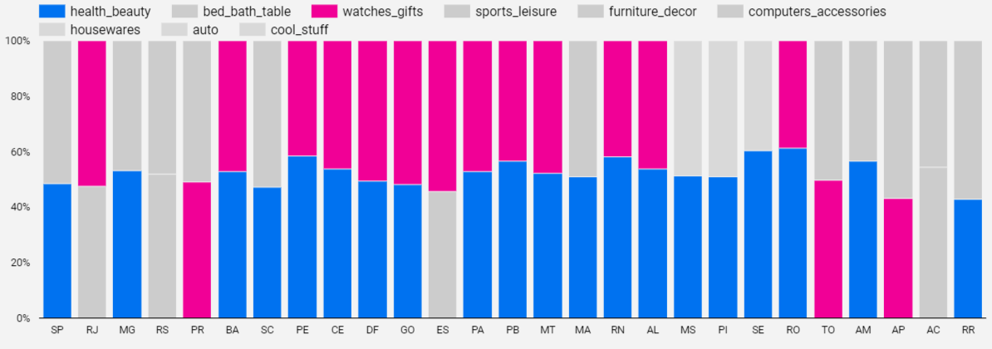
Top 2 Product Category by State
By just looking we see the trend of Healthy_beauty and watches_gifts are present in most of the cities. Other categories such as housewares or computer accessories might be more seasonal.
Customers prefer shopping luxurious products in Brazil.

Slide 7
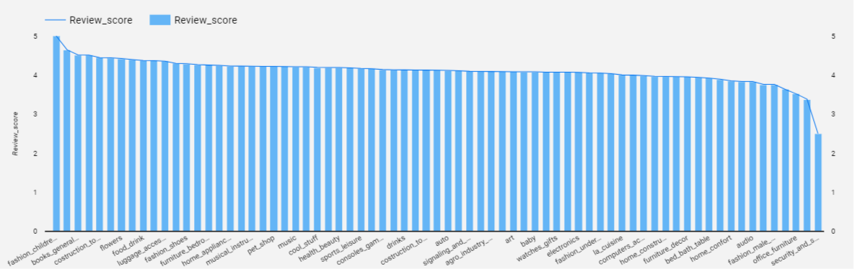
Customer reviews on Product Categories
Here we note that in terms of rating we see that fashion, health and beauty also mark with good reviews from above 3,5, this means the sellers are doing a good job.
We should focus on these products to ensure good customer experience as they are bringing the highest revenue.

Slide 8
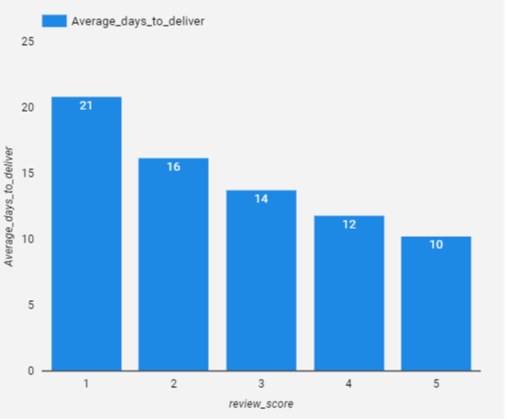
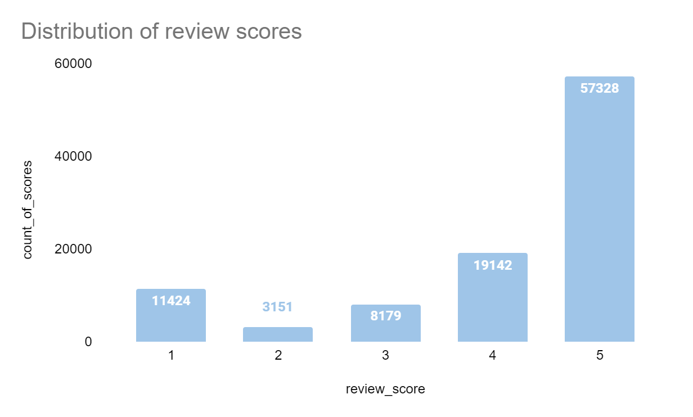
Customer reviews on Delivery times
Overall product reviews are positive with the average score above 4. 84% are all positive reviews and 26% are all negative reviews.
Upon further analysis on the delivery times and review scores, when delivery times are more than 12 days, reviews are lower and more on the negative side.
Reducing delivery times below 2 weeks would affect customer satisfaction.

Slide 9
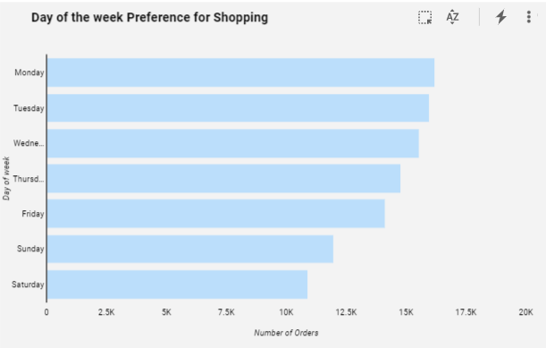
Day of the week
Customers prefer to shop during the weekdays and Monday seems to be the best day for shopping.

Slide 10
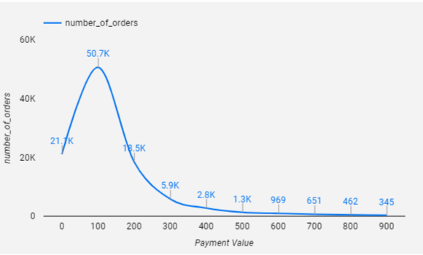
Payment Value
We can clearly see that our customers prefer product prices that are in the range less than R$200.
Knowing this will provide insights into knowing the purchase power distribution of our customers.

Slide 11
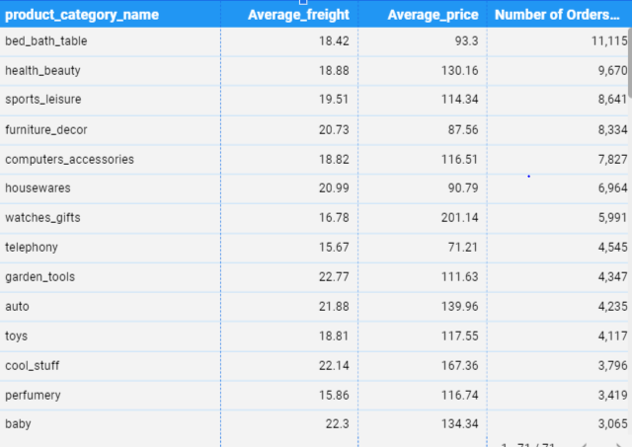
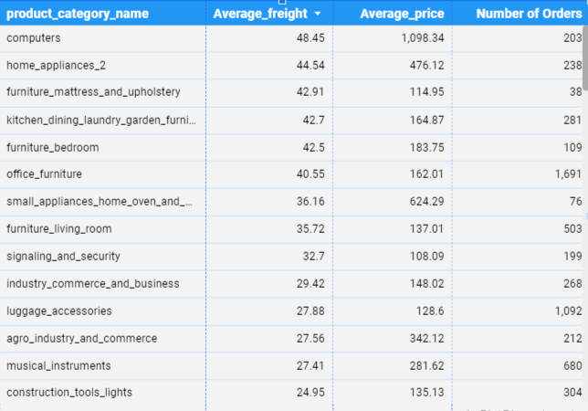
Freight Value Analysis
The higher the freight values the lesser the orders, and we can see that the product categories with high freight values have fewer number of orders.

Slide 12
Recommendations
Implement what is being done in Sao Paulo and we can be able to explore the possibility of expanding into new states and markets.
Customer prefer low priced item, therefore maintain the price and increase more campaigns such as Black fridays.
Customers prefer Free shipping which is close to low freight values, thereby increase free delivery for product categories that are least ordered.
Customers prefer fast delivery, reduce the number of delivery time, find more shorter routes and maintain a good service
Customer prefer to buy products that have good reviews, product reviews should be visible to the consumer.
When customers are not happy with the product, offer them free replacement, giveaways to try and resolve issues in time.

Slide 13
Conclusion
From the analysis, we can conclude that customers can be retained and satisfied if the product is delivered on time, prices are lower as well as freight values. These are most relevant sales drivers.

